Slide 1









$$a)$$
$$b)$$
$$c)$$
$$γ$$
$$γ$$
$$ω^{∗}$$
$$ω^{∗}$$
$$ω$$
$$ω$$

Slide 2









$$a)$$
$$b)$$
$$s$$
$$c)$$
$$s_{1}$$
$$γ_{1}$$
$$s_{1}$$
$$s_{2}$$
$$γ_{2}$$
$$ω$$
$$−ω^{∗}$$

Slide 3





















$$a)$$
$$y(z,λ)$$
$$b)$$
$$y(z,\hat{h}λ)$$
$$c)$$
$$y(\hat{g}z,\hat{h}λ)$$
$$s^{′}(λ)$$
$$s^{′}(\hat{h}λ)$$
$$a^{′}(\hat{h}λ)$$
$$s^{′}(\hat{h}λ)$$
$$a(\hat{h}λ)$$
$$s(\hat{h}λ)$$
$${\hat{g}}^{−1}a^{′}(\hat{h}λ)$$
$$a^{′}(λ)$$
$$s(λ)$$
$${\hat{g}}^{−1}a(\hat{h}λ)$$
$$a(λ)$$
$$s(\hat{h}λ)$$
$$O$$
$$O$$
$$O$$

Slide 4













$$a)$$
$$y(z,λ)$$
$$b)$$
$$y(z,\hat{h}λ)$$
$$c)$$
$$y(\hat{g}z,\hat{h}λ)$$
$$s(λ)$$
$$s(\hat{h}λ)$$
$$−s^{′}(\hat{h}λ)$$
$$a(λ)$$
$${\hat{g}}^{−1}a\left(\hat{h}λ\right)$$
$$a(\hat{h}λ)$$
$$s^{′}(λ)$$
$$s^{′}(\hat{h}λ)$$
$$−s(\hat{h}λ)$$
$$O$$
$$O$$
$$O$$

Slide 5
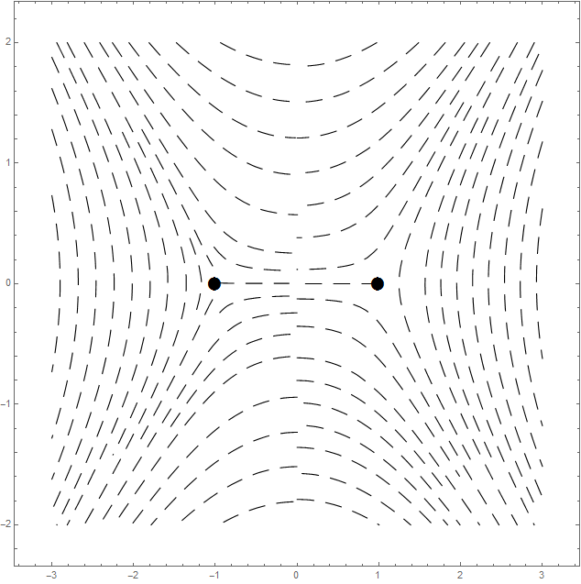
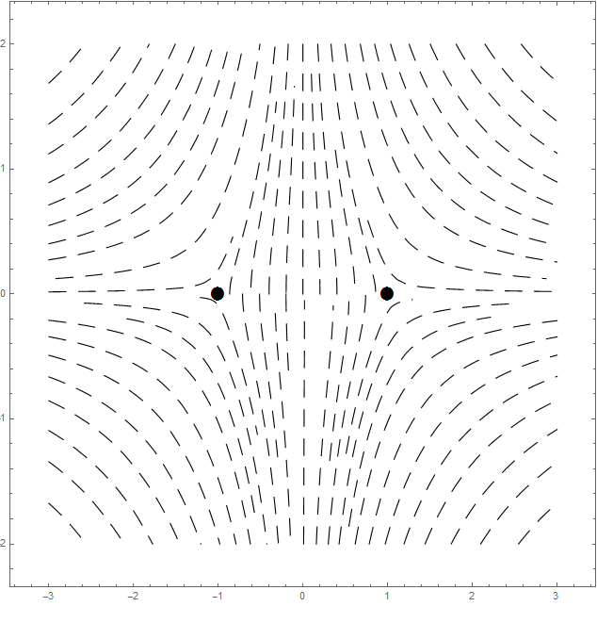










$$a)$$
$$b)$$
$$c)$$
$$S[s_{1/2}]$$
$$S^{T}[s_{3/2}]$$
$$ω$$
$$γ$$
$$ω^{∗}$$
$$S^{T}[s_{−3/2}]$$
$$S[s_{−1/2}]$$

Slide 6
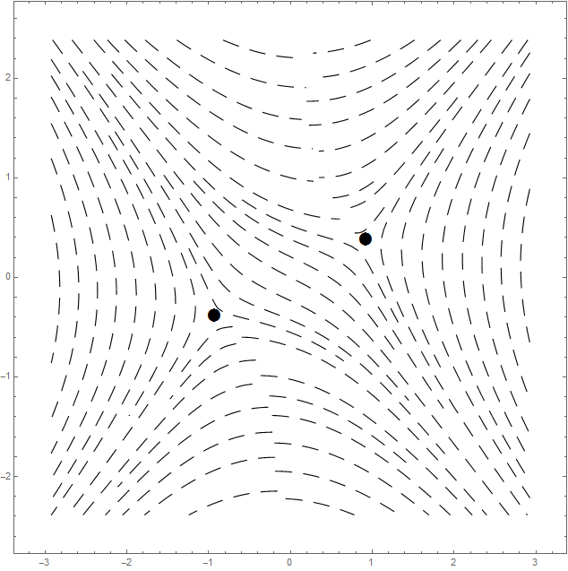
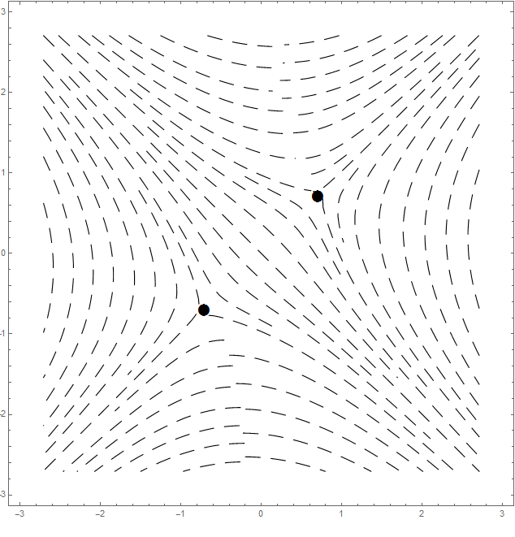
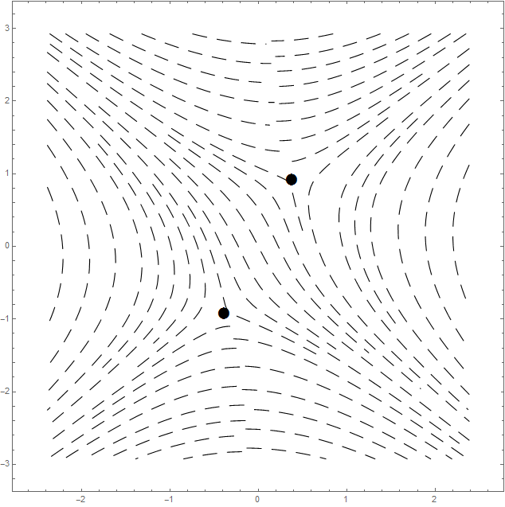
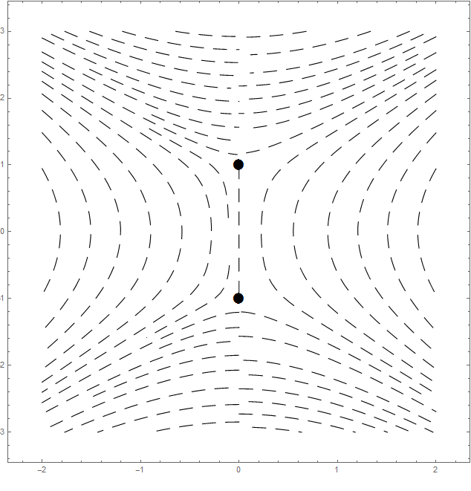
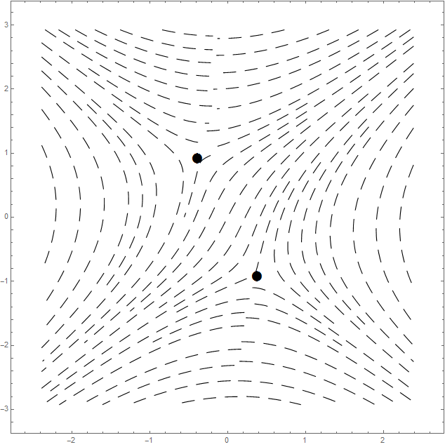
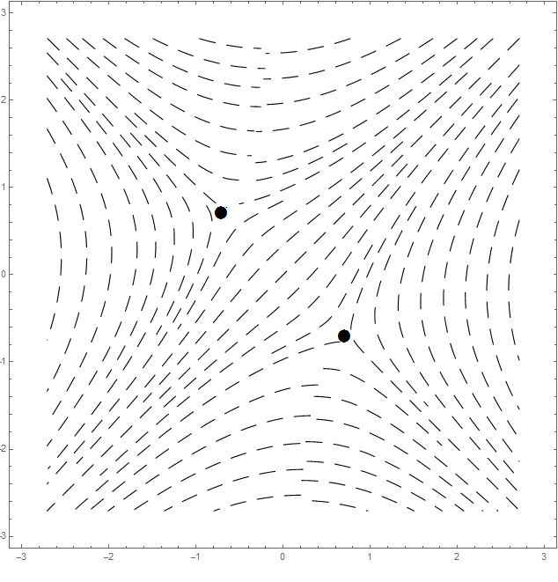
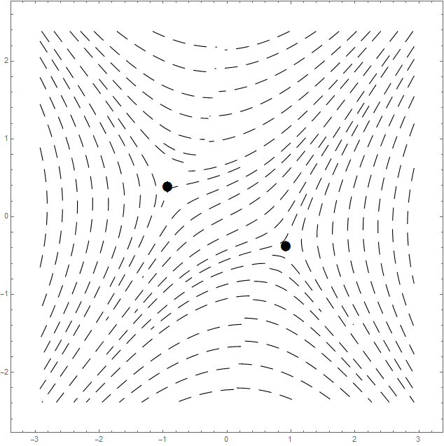








$$μ=1/8$$
$$μ=2/8$$
$$μ=3/8$$
$$μ=4/8$$
$$μ=5/8$$
$$μ=6/8$$
$$μ=7/8$$
$$μ=1$$

